Slide 1
Figures – Chapter 25

Slide 2
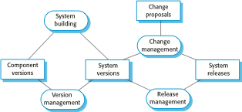
Figure 25.1 Configuration management activities

Slide 3
Figure 25.2 CM terminology
Term | Explanation
Configuration item or software configuration item (SCI) | Anything associated with a software project (design, code, test data, document, etc.) that has been placed under configuration control. There are often different versions of a configuration item. Configuration items have a unique name.
Configuration control | The process of ensuring that versions of systems and components are recorded and maintained so that changes are managed and all versions of components are identified and stored for the lifetime of the system.
Version | An instance of a configuration item that differs, in some way, from other instances of that item. Versions always have a unique identifier, which is often composed of the configuration item name plus a version number.
Baseline | A baseline is a collection of component versions that make up a system. Baselines are controlled, which means that the versions of the components making up the system cannot be changed. This means that it should always be possible to recreate a baseline from its constituent components.
Codeline | A codeline is a set of versions of a software component and other configuration items on which that component depends.
Mainline | A sequence of baselines representing different versions of a system.
Release | A version of a system that has been released to customers (or other users in an organization) for use.
Workspace | A private work area where software can be modified without affecting other developers who may be using or modifying that software.
Branching | The creation of a new codeline from a version in an existing codeline. The new codeline and the existing codeline may then develop independently.
Merging | The creation of a new version of a software component by merging separate versions in different codelines. These codelines may have been created by a previous branch of one of the codelines involved.
System building | The creation of an executable system version by compiling and linking the appropriate versions of the components and libraries making up the system.

Slide 4
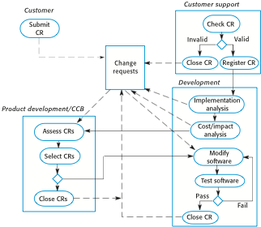
Figure 25.3 The change management process

Slide 5
Figure 25.4 A partially completed change request form
Change Request Form
Project: SICSA/AppProcessing Number: 23/02
Change requester: I. Sommerville Date: 20/01/09
Requested change: The status of applicants (rejected, accepted, etc.) should be shown visually in the displayed list of applicants.
Change analyzer: R. Looek Analysis date: 25/01/09
Components affected: ApplicantListDisplay, StatusUpdater
Associated components: StudentDatabase
Change assessment: Relatively simple to implement by changing the display color according to status. A table must be added to relate status to colors. No changes to associated components are required.
Change priority: Medium
Change implementation:
Estimated effort: 2 hours
Date to SGA app. team: 28/01/09 CCB decision date: 30/01/09
Decision: Accept change. Change to be implemented in Release 1.2
Change implementor: Date of change:
Date submitted to QA: QA decision:
Date submitted to CM:
Comments:

Slide 6
Figure 25.5 Derivation history
// SICSA project (XEP 6087)
//
// APP-SYSTEM/AUTH/RBAC/USER_ROLE
//
// Object: currentRole
// Author: R. Looek
// Creation date: 13/11/2009
//
// © St Andrews University 2009
//
// Modification history
// Version Modifier Date Change Reason
// 1.0 J. Jones 11/11/2009 Add header Submitted to CM
// 1.1 R. Looek 13/11/2009 New field Change req. R07/02

Slide 7
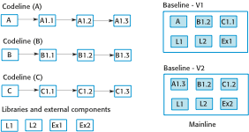
Figure 25.6 Codelines and baselines

Slide 8
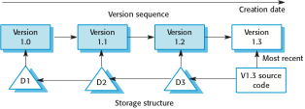
Figure 25.7 Storage management using deltas

Slide 9
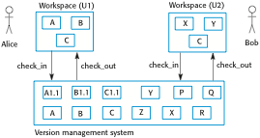
Figure 25.8 Check-in and check-out from a version repository

Slide 10
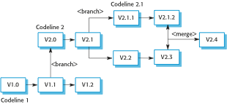
Figure 25.9 Branching and merging

Slide 11
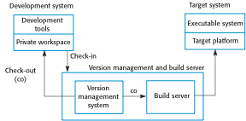
Figure 25.10 Development, build, and target platforms

Slide 12
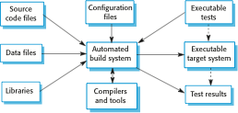
Figure 25.11 System building

Slide 13
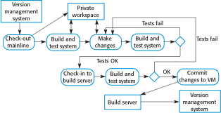
Figure 25.12 Continuous integration

Slide 14
Figure 25.13 Factors influencing system release planning
Factor | Description
Technical quality of the system | If serious system faults are reported which affect the way in which many customers use the system, it may be necessary to issue a fault repair release. Minor system faults may be repaired by issuing patches (usually distributed over the Internet) that can be applied to the current release of the system.
Platform changes | You may have to create a new release of a software application when a new version of the operating system platform is released.
Lehman’s fifth law (see Chapter 9) | This ‘law’ suggests that if you add a lot of new functionality to a system; you will also introduce bugs that will limit the amount of functionality that may be included in the next release. Therefore, a system release with significant new functionality may have to be followed by a release that focuses on repairing problems and improving performance.
Competition | For mass-market software, a new system release may be necessary because a competing product has introduced new features and market share may be lost if these are not provided to existing customers.
Marketing requirements | The marketing department of an organization may have made a commitment for releases to be available at a particular date.
Customer change proposals | For custom systems, customers may have made and paid for a specific set of system change proposals, and they expect a system release as soon as these have been implemented.

